Slide 1
Chapter 11: File System Implementation

Slide 2
Chapter 11: File System Implementation
File-System Structure
File-System Implementation
Directory Implementation
Allocation Methods
Free-Space Management
Efficiency and Performance
Recovery
Log-Structured File Systems
NFS
Example: WAFL File System

Slide 3
Objectives
To describe the details of implementing local file systems and directory structures
To describe the implementation of remote file systems
To discuss block allocation and free-block algorithms and trade-offs

Slide 4
11.1 File-System Structure
To provide efficient and convenient access to the disk, the operating system imposes one or more file systems to allow the data to be stored, located, and retrieved easily.
A file system poses two quite different design problems
The first problem is defining how the file system should look to the user.
This task involves defining a file and its attributes, the operations allowed on a file, and the directory structure for organizing files.
The second problem is creating algorithms and data structures to map the logical file system onto the physical secondary-storage devices.

Slide 5
File-System Structure
I/O transfers between memory and disk are performed in units of blocks.
Each block has one or more sectors
File structure
Logical storage unit
Collection of related information
File system resides on secondary storage (disks)
File system organized into layers
File control block(FCB) – storage structure consisting of information about a file

Slide 6
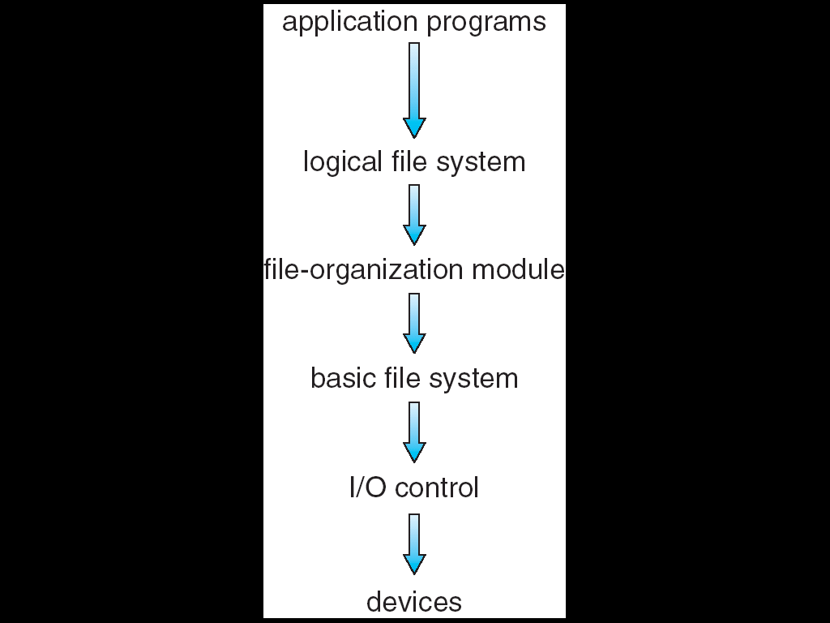
Layered File System
利用系统调用请求文件操作
Such as Open(), read(）
Logical file system
Manage metadata information(File-system structure)
Manage directory structure (symbolic file name, FCB)
File-organization module
Concern files and their logical blocks
Translate logical block addresses to physical block addresses for the basic file system to transfer
Basic file system
Generic commands to the appropriate device driver to read and write physical blocks on the disk
Each physical block is identified by its numeric disk address (e.g. drive 1, cylinder 73,track 2, sector 10)
I/O control
Device drivers
Interrupt handler

Slide 7
Layered File System
Application programs
e.g. fd=open(“/home/labs/lab1/ptcl.c”, O_RDWR);

Slide 8
Layered File System
Logical file system
Manage metadata information
metadata: file-system structure, except the actual data
Manage directory structure provide information for the file organization module
given a symbolic file name
maintains file structure via file control block(FCB);
responsible for protection and security,
fd=open(“/home/labs/lab1/ptcl.c”, O_RDWR);
在内存的文件系统目录表中依据符号文件名查找该文件；
无该文件：若没有搜索到该文件，返回-1；
Cache FCB：若搜索到该文件，将其对应的FCB 装入主存中一个全局的打开文件的FCB表中（AFCB，全局的inode表）；
在文件表中建立表项，设置文件读写偏移量、打开模式等
访问权限检查：在FCB中检查文件的访问权限，如果无相应权限，返回-1；
在进程PCB中建立表项，返回文件描述符fd；
根据文件表中的读写位置获取要访问的文件位置在磁盘上对应的逻辑块号；

Slide 9
Layered File System
File-organization module
Concern files and their logical blocks,
Translate logical block addresses to physical block addresses for the basic file system to transfer
FCB, concerned by he logical file system module, only know the logical blocks of the files
Basic file system needs the physical blocks of the files
The physical blocks containing the data usually do not match the logical numbers
fd=open(“/home/labs/lab1/ptcl.c”, O_RDWR);
将在上层FCB中获取的文件的逻辑块号转换为文件在磁盘上的物理块地址；（驱动器号/圆柱面号/盘面号/扇区号）
逻辑地址→物理地址
free space manager
tracks unallocated blocks and provides these blocks to the file-organization module when requested；

Slide 10
Layered File System
Basic file system
Each physical block is identified by its numeric disk address (e.g. drive 1, cylinder 73，track 2, sector 10)
Generic commands to the appropriate device driver to read and write physical blocks on the disk
such as "retrieve block 123”
fd=open(“/home/labs/lab1/ptcl.c”, O_RDWR);
根据在上层File-organization module获取的文件在磁盘上的物理块地址，给下层(I/O control)发送磁盘读写命令

Slide 11
Layered File System
I/O control
transfer information between the main memory and the disk system with device drivers and interrupt handler
Device drivers
can be thought of as a translator (Command traslator)
Its input consists of high-level commands such as "retrieve block 123."
Its output consists of low-level, hardware-specific instructions that are used by the hardware controller
Interrupt handler
对磁盘等介质进行物理读写等操作
fd=open(“/home/labs/lab1/ptcl.c”, O_RDWR);
Device drivers将上层传来的读写等操作命令转换成具体的磁盘I/O指令，然后由磁盘控制器的中断处理程序完成该文件的具体的数据传输；

Slide 12
11.2 File-System Implementation 11.2.1 Overview
Several on-disk and in-memory structures are used to implement a file system.
These structures vary depending on the operating system and the file system

Slide 13
On-Disk File System Structures
On disk, the file system may contain information about
How to boot an operating system stored there；
The total number of blocks；
The number and location of free blocks；
The directory structure，以实现文件的按名查找
The FCB or Index Node， 记录每个文件的信息
……

Slide 14
On-Disk File System Structures
对于每个磁盘，需要设置（fdisk设置，与文件系统无关）
Master boot record （MBR）
MBR：存储boot code，以及分区表
其中boot code的主要作用是查找活动分区，装入活动分区的boot control block
对于每个分区（volume），文件系统需要在硬盘上设置
A boot control block （引导操作系统）
A volume control block (per volume)
例如 Superblock in UNIX
A directory structure (per volume)
A per-file FCB （或索引结点）
由逻辑格式化format设置

Slide 15
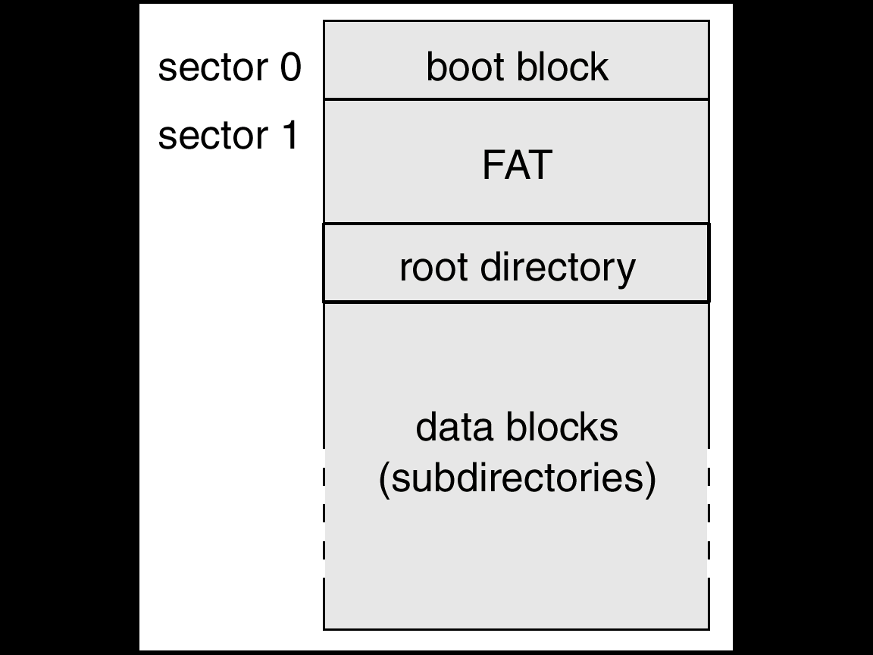
FAT文件系统每个分区的布局（per partition）
FAT文件系统的磁盘布局及数据结构

Slide 16
Ext文件系统每个分区的布局（per partition）
引导块（boot block）
占据文件系统的开始，一般是一个扇区
含有被读入机器中起引导或初启OS的引导代码
每个文件系统都有一个引导块（可能是空的）
超级块 ( volume control block, directory structure )
魔数：文件系统类型
文件系统的规模（多大空间）
文件系统空闲块的数目
文件系统中可用的空闲块表（链表的表头）
文件系统中下一个空闲块的下标
索引节点表的大小（决定改文件系统能创建的文件数）
文件系统中空闲索引节点的数目
文件系统中空闲索引节点表
空闲索引节点表中下一个空闲索引节点的下标
空闲块表的锁字段和空闲索引节点表锁字段
指明超级块被修改过的标记
索引节点表 (per-file FCB )（有一个特殊的结点---根索引结点）
数据块
引导块
超级块
索引节点表
数据块
说明文件系统的类型
存放文件系统的基本参数

Slide 17
讨论
当前磁盘空间还剩余500G。
当将优盘的文件复制到该磁盘时，报错，磁盘空间满了。
可能是什么原因？
没有空闲的索引结点以新建文件。
小文件太多。

Slide 18
On-Disk File System Structures (Cont)
A boot control block (per volume)
Contain information needed by the system to boot an operating system from that volume.
If the disk does not contain an operating system, this block can be empty.
It is typically the first block of a volume.
In UFS, it is called the boot block;
in NTFS, it is the partition boot sector.

Slide 19
On-Disk File System Structures (Cont)
A volume control block (per volume)
Contains volume (or partition) details, such as
the number of blocks in the partition,
size of the blocks,
free-block count and free-block pointers,
free FCB count and FCB pointers.
In UFS (Ext2,3等), this is called a superblock;
In NTFS, it is stored in the master file table.

Slide 20
On-Disk File System Structures (Cont)
A directory structure (per file system)
Used to organize the files.
In UFS, this includes file names associated inode numbers.
In NTFS it is stored in the master file table.

Slide 21
On-Disk File System Structures (Cont)
A per-file FCB
contains many details about the file, including
file permissions
Ownership
Size
location of the data blocks.
In UFS, this is called the inode.
In NTFS, this information is actually stored within the master file table, which uses a relational database structure, with a row per file.

Slide 22
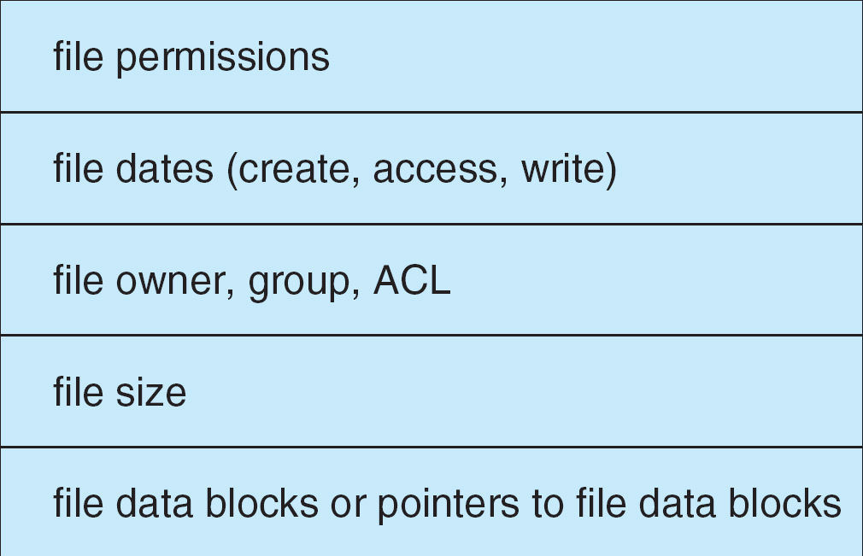
A Typical File Control Block

Slide 23
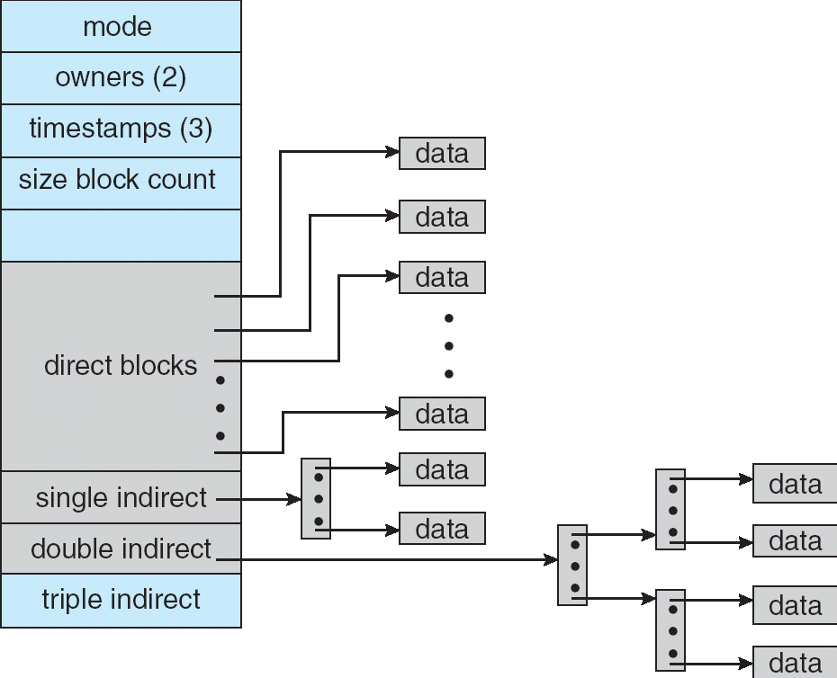
Inode in UNIX (ext3)

Slide 24
回顾：OS的引导过程：Computer Startup--加电
电源开关打开,机器开始供电,主板的控制芯片组会向CPU发出并保持一个RESET （重置）信号，让CPU 恢复到初始状态。
当芯片组检测到电源已经开始稳定供电时，就会撤去RESET 信号（相当于松开台式机的重启键，早期台式机提供RESET按钮）
CPU 就从0xffff0 处开始执行指令。
该地址在系统BIOS （Basic Input/Output System，基本输入输出系统）的地址范围内，大部分系统BIOS 厂商放在这里的都只是一条跳转指令，跳到系统BIOS 真正的启动代码处。

Slide 25
Computer Startup--自检
系统BIOS 的启动代码首先要做的事情是进行POST（Power-On Self Test，加电后自检）
POST 的主要任务是检测系统中一些关键设备是否存在和能否正常工作，例如内存、显卡、键盘等设备
由于POST 是最早进行的检测过程，此时尚未初始化显卡，如果系统BIOS 在POST 的过程中发现了一些致命错误，有时不会将错误信息在屏幕上显示
例如没有找到内存或者内存有问题（此时只会检查640K 常规内存），或其它关键设备，系统BIOS 就会直接控制喇叭发声来报告错误，声音的长短和次数代表了错误的类型

Slide 26
Computer Startup--初始化设备
接下来系统BIOS 将查找显卡的BIOS，显卡BIOS在ROM 芯片的起始地址通常设在0xC0000 处，系统BIOS 在该地址处找到显卡BIOS 之后就调用它的初始化代码，由显卡BIOS 来初始化显卡
此时多数显卡都会在屏幕上显示出一些初始化信息，介绍生产厂商、图形芯片类型等内容
系统BIOS 接着会查找其它设备的BIOS 程序，找到之后同样要调用这些BIOS内部的初始化代码来初始化相关的设备

Slide 27
Computer Startup--测试设备
查找完所有其它设备的BIOS 之后，系统BIOS 将显示出它自己的启动画面，其中包括有系统BIOS 的类型、序列号和版本号等内容
接着系统BIOS 将检测和显示CPU 的类型和工作频率，然后开始测试所有的RAM （Random Access Memory），并同时在屏幕上显示内存测试的进度
内存测试通过之后，系统BIOS 将开始检测系统中安装的一些标准硬件设备，包括硬盘、光驱、串口、并口、软驱等
另外绝大多数较新版本的系统BIOS 在这一过程中还要自动检测和设置内存的定时参数、硬盘参数和访问模式等
标准设备检测完毕后，系统BIOS 内部的支持即插即用的代码将开始检测和配置系统中安装的即插即用设备，每找到一个设备之后，系统BIOS 都会在屏幕上显示出设备的名称和型号等信息，同时为该设备分配中断（INT）、DMA （Direct Memory Access，直接存储器存取）通道和I/O （Input/Output，输入输出）端口等资源

Slide 28
Computer Startup--更新SECD
所有硬件都检测配置完毕后，多数系统BIOS 会重新清屏并在屏幕上方显示出一个表格，其中概略地列出了系统中安装的各种标准硬件设备，以及它们使用的资源和一些相关工作参数
接下来系统BIOS 将更新ESCD （Extended System Configuration Data，扩展系统配置数据）
ESCD （Extended System Configuration Data，扩展系统配置数据）是系统BIOS 用来与操作系统交换硬件配置信息的一种手段，这些数据被存放在CMOS （Complementary Metal Oxide Semiconductor，互补金属氧化物半导体）中；
操作系统将根据这些信息配置与使用设备
有些设备安装后需要重启机器

Slide 29
Computer Startup--启动操作系统
ESCD 更新完毕后，系统BIOS 的启动代码将进行它的最后一项工作，即根据用户指定的启动顺序从软盘、硬盘及光驱等启动操作系统
以Windows为例
系统BIOS将启动盘（一般是主硬盘）的主引导扇区（MBR, 主引导记录）读入到内存的0x7c00处；
检查0x7dfe 地址的内存，如果其内容是0xAA55，就跳转到0x7c00 处执行MBR （Master Boot Record，主引导记录， 512字节）；
MBR 从分区表（Partition Table）中找到第一个活动分区（Active Partition，一般是C 盘第一个分区），然后按照类似方式读取并执行这个活动分区的引导扇区（Partition Boot Sector），引导扇区负责读取并执行NTLDR （NT Loader，Windows NT的加载程序），完成Windows的启动 ；
如果你自己写一个操作系统，一般是从修改主引导扇区开始（汇编）
因为BIOS将主引导扇区装入到内存的0x7c00处并执行之；
需要对所用文件系统在磁盘上的布局相当熟悉；

Slide 30
In-Memory File System Structures
The in-memory information is used for both file-system management and performance improvement via caching.
The data are loaded at mount time and discarded at dismount.
In-memory mount table
In-memory directory-structure
System-wide open-file table，如UNIX中
索引结点表（活动的索引结点，在磁盘索引结点基础上添加了一些信息）
文件表
Per-process open-file table (UNIX,：PCB中的U区)

Slide 31
In-Memory File System Structures(Cont)
In-memory mount table ( or partition table )
Contains information about each mounted volume (or mounted partition).
In-memory directory-structure
Cache holds the directory information of recently accessed directories.
For directories at which volumes are mounted, it can contain a pointer to the volume table.)

Slide 32
In-Memory File System Structures(Cont)
System-wide open-file table
Contains a copy of the FCB of each open file
As well as other information.（e.g. file table）
Per-process open-file table
Contains a pointer to the appropriate entry in the system-wide open-file table, as well as other information.

Slide 33
In-Memory File System Structures(Cont)
The following figure illustrates the necessary file system structures provided by the operating systems.
Figure 12-3(a) refers to opening a file.
Figure 12-3(b) refers to reading a file.

Slide 34
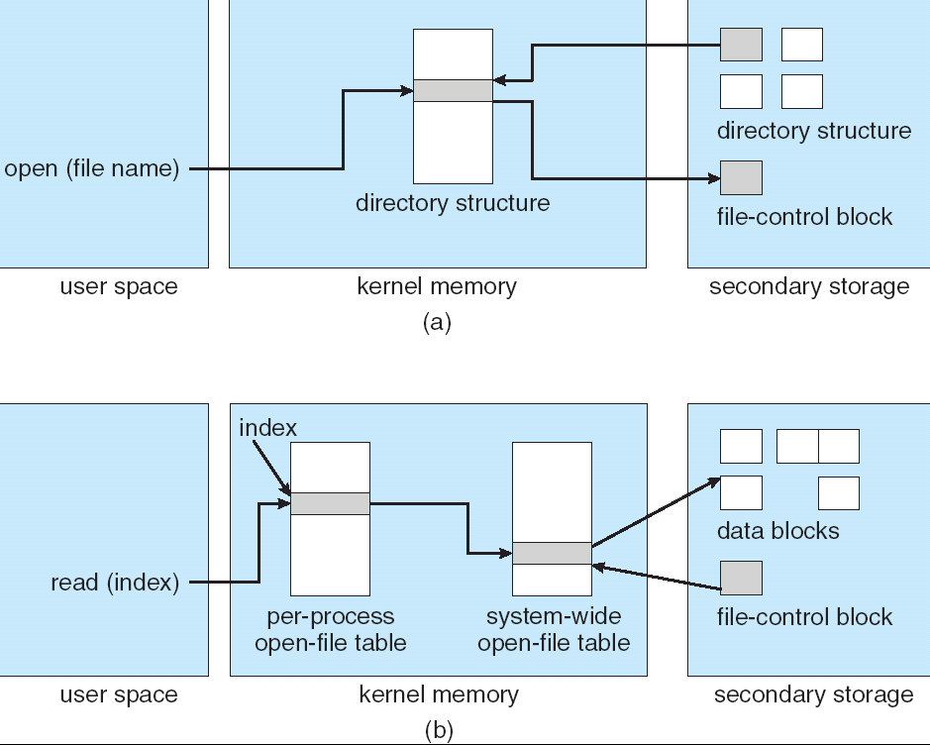
In-Memory File System Structures
open()
read()、write、close等

Slide 35
Open()的过程
结合上页与下页图表。
1. 根据要打开的文件名查找目录项。如果目录项不在内存中，则从硬盘上读取该目录项到内存中;
2. 根据目录项找到要打开文件的FCB，读入全局打开文件表;
3. 在进程的局部打开文件表中建立指向全局打开文件表中的相应项的指针;
4. Open() 返回该文件在局部打开文件表中的偏移;
关闭文件的基本过程或基本思想
Open()操作的逆过程;

Slide 36
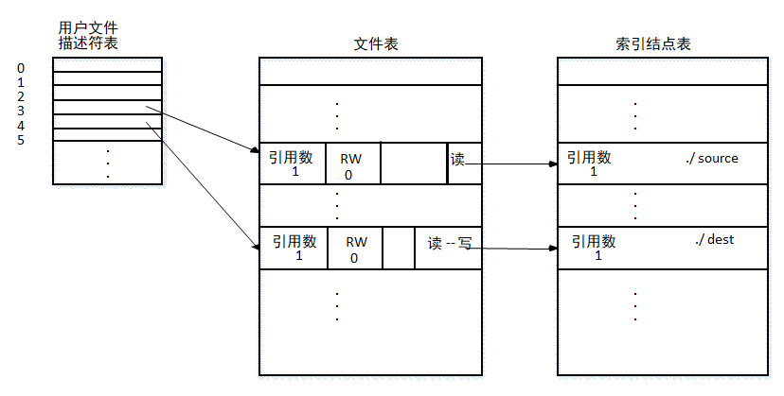
回顾：系统调用open() 、creat()
fdrd=open(“source”,O_RDONLY);
fdwt=creat(“dest”,0666);

Slide 37
回顾：系统调用open()、read()、write()
请参见“UNIX操作系统设计”，第80页

Slide 38
Create a new file
The process: 
An application program calls the logical file system.
Logical file system allocates a new FCB.
Read the appropriate directory into memory, updates it with the new file name and FCB, and writes it back to the disk.
About directory
Some operating systems (including UNIX) treat a directory as a file.
Some operating systems (including Windows NT) treat a directories as entities separate from files. (separate system calls for files and directories.)

Slide 39
Open a file
The process: 
The directory structures is searched for the given file name. (Parts of the directory structure are usually cached in memory to speed directory operations.)
The FCB is copied into a system-wide open-file table in memory.
An entry is made in the per-process open-file (with a pointer to the entry in the system-wide open-file table, a pointer to the current location in the file, the access mode in which the file is open, ……)
The open call returns a pointer to the appropriate entry in the per-process open-file. All file operations are then performed via this pointer.
About the pointer returned by the open call
Unix systems refer to it as a file descriptor.
Windows 2000 refers to it as a file handle.

Slide 40
Close a file
The process: 
The per-process table entry is removed, and the system-wide entry’s open count is decremented.
When all users that have opened the file close it, the updated file information is copied back to the disk-based directory structure and the system-wide open-file table entry is removed.

Slide 41
UNIX实例
Per-process open-file table
File table (System-wide)
Index-nodes table（FCB）
fd=open(filename)
num=read(fd, buf,num)

Slide 42

多选题
答案解析
1分
答案解析
若文件f1的硬链接为f2，两个进程分别打开f1和f2，获取对应的文件描述符fd1和fd2，则下列叙述中，正确的是（）。（2017）
f1和f2的读写指针位置保持相同
f1和f2共享同一个内存索引结点
fd1和fd2分别指向各自的用户打开文件表中的一项
B
A
仅III
B
仅II、III
C
仅I、II
D
I、II 和 III
提交
可为此题添加文本、图片、公式等解析，且需将内容全部放在本区域内。正常使用需3.0以上版本

Slide 43
11.2.2 Partition and Mounting
A disk can be sliced into multiple partitions
A volume can span multiple partitions on multiple disks (e.g RAID)
Each partition can be either :
"raw“-- containing no file system, disk is used where no file system is appropriate.
UNIX swap space can use a raw partition, as it uses its own format
some databases use raw disk and format the data to suit their needs.
"cooked“ --containing a file system

Slide 44
Partition and Mounting (Cont.)
Boot information
Can be stored in a separate partition. It has its own format, since at boot time the system does not have file-system device drivers loaded and therefore cannot interpret the file-system format
Usually a sequence series of blocks, loaded as an image into memory
Dual-booted system– Multiple operating systems can be installed on such a system
boot loader:
understands multiple operating systems and multiple file systems
occupy the boot space.

Slide 45
Partition and Mounting (Cont)
Root partition
Contains the operating-system kernel and sometimes other system files
Mounted at boot time
Other volumes can be automatically mounted at boot or Manually mounted later
In-memory mount table structure
contains information about each mounted volume.
Microsoft Windows-based systems mount each volume in a separate name space, denoted by a letter and a colon.
On UNIX, file systems can be mounted at any directory--mount point

Slide 46
Partition and Mounting (Cont)
As part of a successful mount operation, the operating system verifies that the device contains a valid file system.
It does so by asking the device driver to read the device directory and verifying that the directory has the expected format.
If the format is invalid, the partition must have its consistency checked and possibly correct, either with or without user intervention.
Finally, the operating system notes in its in-memory table structure that a file system is mounted, and the type of the file system.

Slide 47
11.2.3 Virtual File Systems (VFS)
UNIX，Windows可支持多种文件系统类型
数据可在不同的文件系统之间复制
如何实现的？
How can users seamlessly move between file-system types as they navigate the file-system space?
How does an operating system allow multiple types of file systems to be integrated into a directory structure?

Slide 48
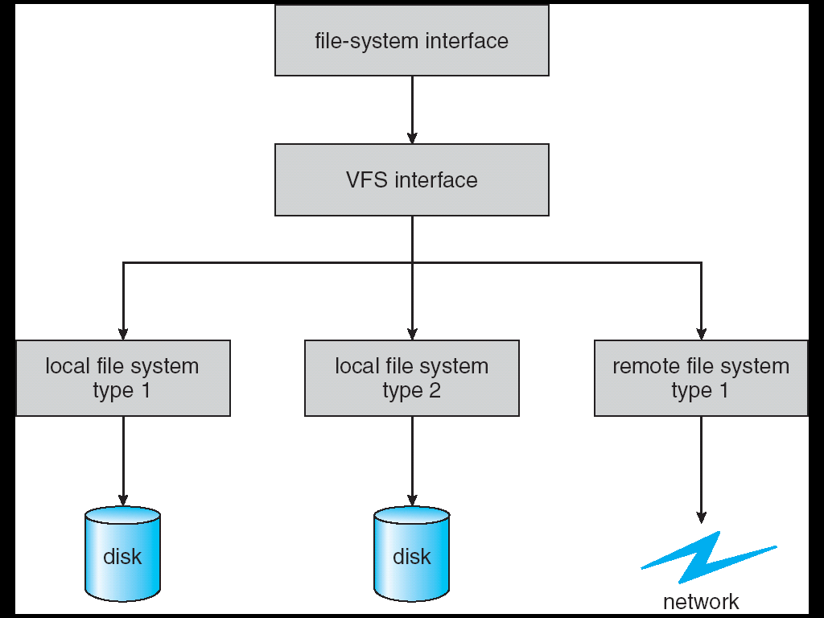
Schematic View of Virtual File System

Slide 49
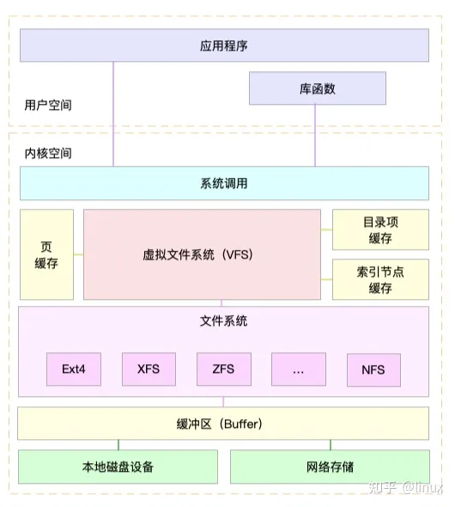
Schematic View of Virtual File System

Slide 50
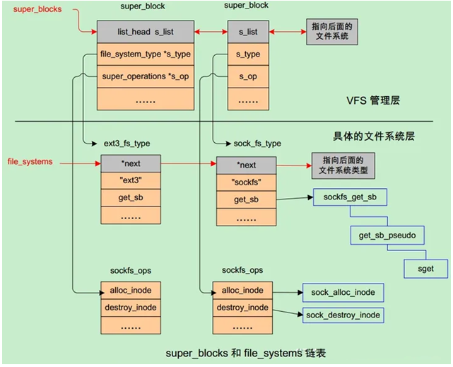
虚拟文件系统的简单实现
VFS描述文件系统使用超级块和inode 的方式，所谓超级块就是对所有文件系统的管理机构，每种文件系统都要把自己的信息挂到super_blocks这么一个全局链表上。
内核中是分成2个步骤完成：
首先每个文件系统必须通过register_filesystem函数将自己的file_system_type挂接到file_systems这个全局变量上，
然后调用kern_mount函数把自己的文件相关操作函数集合表挂到super_blocks上。每种文件系统类型的读超级块的例程（get_sb）必须由自己实现。
详情参见：https://zhuanlan.zhihu.com/p/654895307

Slide 51
Virtual File Systems
Virtual File Systems (VFS) provide an object-oriented way of implementing file systems.
VFS allows the same system call interface (the API) to be used for different types of file systems.
The API is to the VFS interface, rather than any specific type of file system.
虚拟文件系统(VFS)是物理文件系统与文件系统服务之间的一个接口层（VFS Interface），它对每个物理文件系统的所有细节进行抽象，并为这些不同的文件系统提供了一个统一的系统调用接口。
VFS
并不是一种实际的文件系统,只是系统核心的一个管理模块；
它只存在于内存中，不存在于任何外存空间;
VFS在系统启动时建立，在系统关闭时撤销。

Slide 52
11.3 Directory Implementation
The selection of directory-allocation and directory-management algorithms significantly affects the efficiency, performance, and reliability of the file system
Linear list of file names with pointer to the data blocks.
simple to program
time-consuming to execute
finding a file requires a linear search.
Hash Table – linear list with hash data structure.
decreases directory search time
collisions – situations where two or more file names hash to the same location
fixed size, and the dependence of the hash function on that size
数据结构中的各种树,例如B+树，AVL树等

Slide 53
11.4 Allocation Methods
An allocation method refers to how disk blocks are allocated for files
物理文件的结构
Objective
有效地利用外存空间（额外的磁盘空间、碎片）
提高对文件的访问速度（随机存取）
保证可靠性（是否容易导致文件的损坏）
易于文件扩展
实现难度
Methods：
Contiguous allocation
Linked allocation
Indexed allocation

Slide 54
11.4.1 Contiguous Allocation
Each file occupies a set of contiguous blocks on the disk
类似于内存的动态分区管理

Slide 55
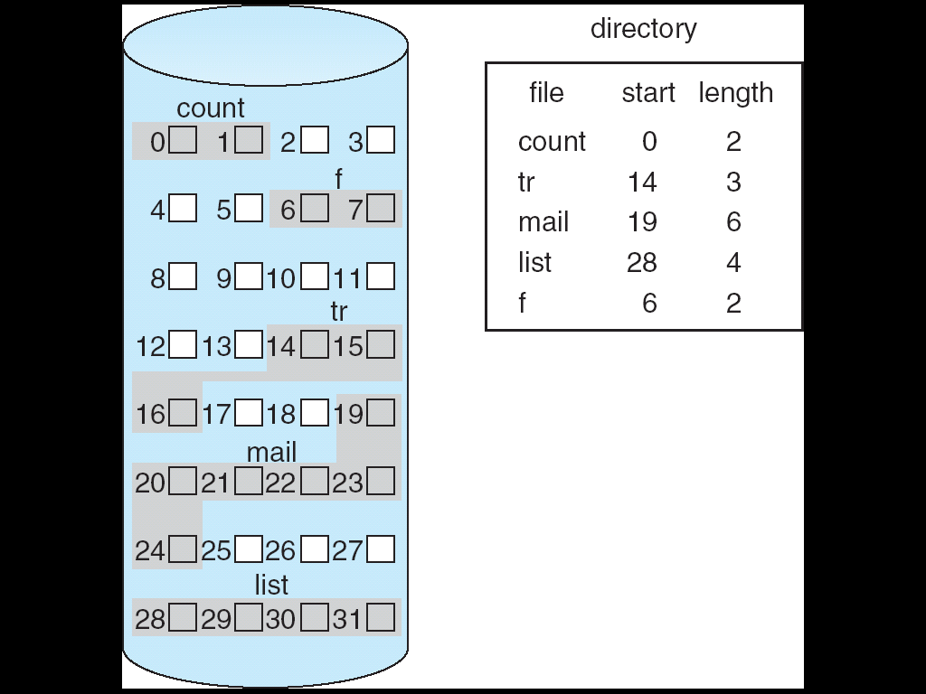
Contiguous Allocation of Disk Space
理解：如何通过文件名，访问文件内容。
文件名→查找文件目录表→获取文件的FCB→获取文件数据块的起始块与长度→根据要访问的文件位置指针→可以直接找到要访问的数据块

Slide 56
Contiguous Allocation (Cont)
Each file occupies a set of contiguous blocks on the disk
Simple – only starting location (block #) and length (number of blocks) are required
Random access
存取速度快，效率高
适合于文件内容不进行变动的情况 eg. 虚存的对换区
NTFS：尽量地把一个文件存放到一些连续的磁盘块中
Wasteful of space (dynamic storage-allocation problem)
External fragmentation
Compact---compacts all free space into one contiguous space
To determine how much space is needed for a file before it is created
Files cannot grow
分配方法：best fit， first fit， worst fit， next fit

Slide 57
Extent-Based Systems
Many newer file systems (i.e. Veritas file system，Ext4等) use a modified contiguous allocation scheme
Extent-based file systems allocate disk blocks in extents
An extent is a contiguous block of disks
Extents are allocated for file allocation
A file consists of one or more extents.
External fragmentation
Ext4文件系统：
以一个扩展为单位分配磁盘空间，而不是以磁盘块为分配单位(ext3)；

Slide 58
Contiguous Allocation (Cont)
Mapping from logical to physical address
假设每个磁盘块的大小(block size)为512 bytes
给定要访问文件的逻辑地址LA（即文件指针，或偏移量，要访问的文件中的位置），则
Q
LA/512
R
LA除以512（block size），商为Q，余数为R
(LA, Q, R的含义，类似于内存分页管理中的页号与页内偏移量)
FCB中给出：starting address=文件的第一个磁盘块号
Block to be accessed =starting address +Q
Displacement into block = R

Slide 59
11.4.2 Linked Allocation
Each file is a linked list of disk blocks: blocks may be scattered anywhere on the disk.
block =
pointer
data

Slide 60
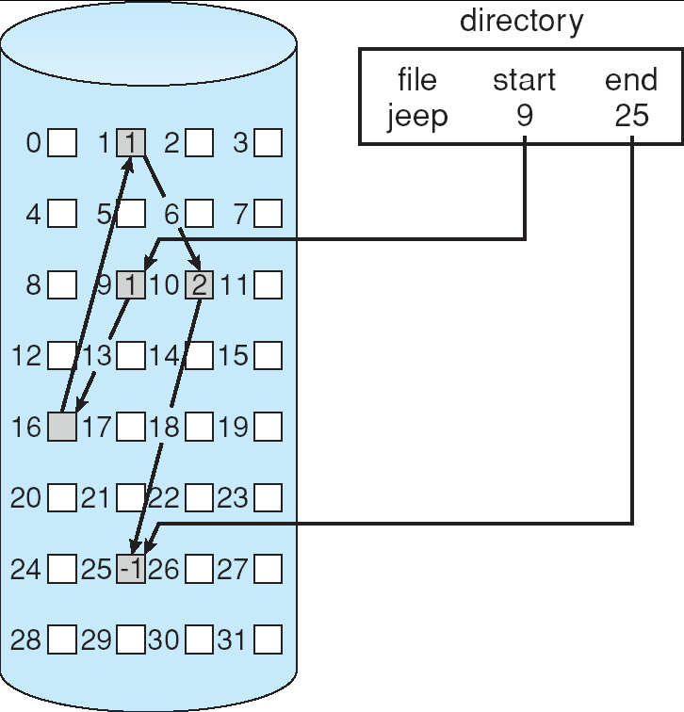
Linked Allocation
隐式链接
理解：如何通过文件名，访问文件内容。
文件名→查找文件目录表→获取文件的FCB→获取文件数据块的首块块与最后块→根据要访问的文件位置指针→顺序依次找到要访问的数据块

Slide 61
Linked Allocation (Cont.)
Simple – need only starting address
No external fragmentation
The size of a file need not be declared when that file is created
Need space to stored pointers
No random access
Lower reliability---the pointers scatter all over the disk, they will be ease to lose or be damaged

Slide 62
Linked Allocation (Cont.)
Mapping from logical to physical address
假设每个磁盘块的大小(block size)为512 bytes ，其中1个字节作为地址，其余511字节存储数据
Q
LA/511
R
文件偏移量LA除以511（block size），商为Q，余数为R
FCB中给出：文件的第一个磁盘逻辑块的块号；
Block to be accessed is the Qth block in the linked chain of blocks representing the file.
Displacement into block = R

Slide 63
自学：Linked Allocation (Cont.)
File-allocation table (FAT) – disk-space allocation used by MS-DOS、Windows and OS/2.
实质上就是将前面介绍的隐式链接中的Linked域独立出来，构成一个FAT表，专门用于实现磁盘块之间的链接。
又称为显式链接；
支持文件的随机存取
1977年由比尔·盖茨和马斯·麦当劳发明；

Slide 64
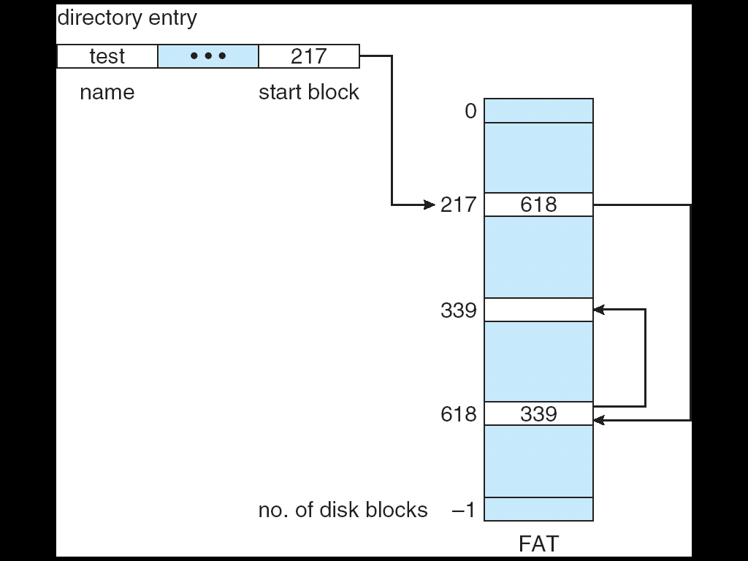
FAT：File-Allocation Table
FAT有关的文件系统
FAT 12
FAT 16
FAT 32
FAT表的大小
块大小的影响
为磁盘的每一个磁盘块建立一个表项，称为FAT表
对于一个文件，其FCB中存储该文件的第一个磁盘块的块号
每个FAT表项存储该文件的下一个磁盘块的块号
每个文件的最后一个磁盘块的FAT表项中存储一个特殊的结尾符
注：FAT中通常称一个磁盘称为一个cluster（簇）
可以随机存取文件的某一个磁盘块
FAT表，有点类似于反置页表

Slide 65
MS-DOS Disk Layout（FAT）

Slide 66

在分区上创建的FAT32文件系统结构
FAT
Copy of FAT
Root directory

Slide 67
FAT—logical to physical address
Mapping from logical to physical address
欲访问的文件偏移量为LA，每个磁盘块大小为512B
LA除以512（block size），商为Q，余数为R
Q
LA/512
R
FCB中给出：文件第一个磁盘块的块号；
Q = 在FAT表中间址Q次
R = displacement into block

Slide 68
FAT有关计算
某磁盘文件区256GB ，回答下列问题：（列出解题步骤）
1、如果采用FAT32文件系统，假定每个磁盘块大小为1KB，问FAT表需要占用几个磁盘块？
2、如果采用FAT32文件系统，每个磁盘块最小可以是多少字节？
3、如果采用FAT16系统，在磁盘空间不变的情况下，每个磁盘块最小可以是多少字节？

Slide 69
FAT有关计算
1、
磁盘总字节数：2³⁰*2⁸ = 2³⁸字节
磁盘总块数：2³⁸/2¹⁰ = 2²⁸ 块
FAT表所占空间（字节数）： 由于每个FAT表项占用32位，因此FAT所需字节数为：2²⁸ *4 字节=2³⁰ 字节
采用FAT所占盘块数为： 2³⁰ / 2¹⁰ 块=2²⁰块
2、磁盘总盘字节数： 2³⁸字节
磁盘的总块数上限： 2³²块 (由于每个FAT表项占用32位，因此可以采用32位对磁盘块进行编址)
每个磁盘块最小可以为： 2³⁸/ 2³²=2⁶字节，即64bytes
3、
磁盘总盘字节数： 2³⁸字节
磁盘的总块数上限： 2¹⁶块 （采用16位对磁盘块进行编址）
每个磁盘块的大小最小可以为： 2³⁸/ 2¹⁶=2²² 字节= 2² * 2²⁰ 字节，即4MB

Slide 70
单选题
答案解析
1分
答案解析
某文件系统的簇和磁盘扇区大小分别是1KB和512B。若一个文件的大小为1026B，则系统分配给该文件的磁盘空间大小是（）。(2017)
D
每个簇大小1KB，分配时以簇为单位，文件大小为1026B，需要分配给该文件2个簇，即2048B。
A
1026B
B
1536B
C
1538B
D
2048B
提交
可为此题添加文本、图片、公式等解析，且需将内容全部放在本区域内。正常使用需3.0以上版本

Slide 71
11.4.3 Indexed Allocation
Brings all pointers together into the index block.
Logical view.
数据块
索引块，其内容是数据块的索引表
index table

Slide 72
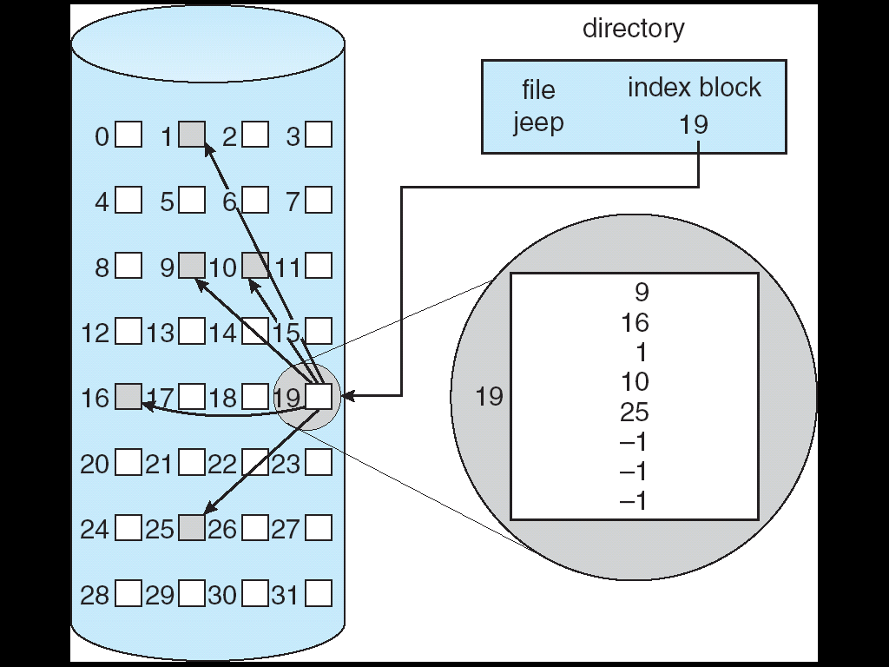
Example of Indexed Allocation
理解：如何通过文件名，访问文件内容。
文件名→查找文件目录表→获取文件的FCB→索引块→根据要访问的文件位置→从索引表中直接获取要访问的数据块

Slide 73
Indexed Allocation (Cont.)
Random access
The size of a file need not be declared when that file is created
No external fragmentation
waste space
dynamic access without external fragmentation, but have overhead of index block.
The pointer overhead of the index block is generally greater than that of linked allocation

Slide 74
Indexed Allocation (Cont.)
Mapping from logical to physical
In a file of maximum size of 128K bytes, and block size of 512 bytes. We need only 1 block for index table.
文件大小128K bytes (2¹⁷ bytes)，一个磁盘块可存储512 bytes (2⁹ bytes)，因此该文件需要256个磁盘块存储其文件内容(2¹⁷/2⁹=256)。如果每个索引项占用一个字节，作为索引块的一个磁盘块可以有512个索引项)
Q
LA/512
R
文件偏移量LA除以512（block size），商为Q，余数为R
FCB中给出：索引块的块号，其内容是索引表（index table）；
Q = displacement into index table
R = displacement into block

Slide 75
Indexed Allocation – Mapping (Cont.)
Index block management
Linked scheme – Link blocks of index table (no limit on size).
Multilevel index
e.g. Two-level index (maximum file size is 512³)
Combined scheme（混合）
UNIX
Direct blocks, single indirect, double indirect, triple indirect

Slide 76
Index block management
Linked scheme – Link blocks of index table (no limit on size).
假设每个磁盘块的大小(block size)为512 bytes
索引块中一个字节(项)作为索引块之间的链接地址，其余511项存放数据块号
Q₁
LA / (512 x 511)
R₁
Q₁ = block of index table
R₁ is used as follows:
Q₂
R₁ / 512
R₂
Q₂ = displacement into block of index table
R₂ = displacement into block of file
注：如果索引块中一项为一个字节时寻址范围太小，可以采用多个字节，或者增大磁盘块的大小，以减少磁盘块的数量

Slide 77
Index block management
Multilevel index

outer-index
index table
file

Slide 78
Index block management
假设每个磁盘块的大小(block size)为512 bytes
Two-level index (maximum file size is 512³)
Q₁
LA / (512 x 512)
R₁
Q₁ = displacement into outer-index
R₁ is used as follows:
Q₂
R₁ / 512
R₂
Q₂ = displacement into block of index table
R₂ = displacement into block of file

Slide 79
Combined Scheme: UNIX (4K bytes per block)
早期Unix研究发现：80%以上文件 < 10KB
目标：既能存储大文件，又能快速访问小文件
索引结点采用了一种混合结构存储文件块

Slide 80
Combined Scheme: UNIX (4K bytes per block)
早期Unix研究发现：80%以上文件 < 10KB
目标：既能存储大文件，又能快速访问小文件

Slide 81
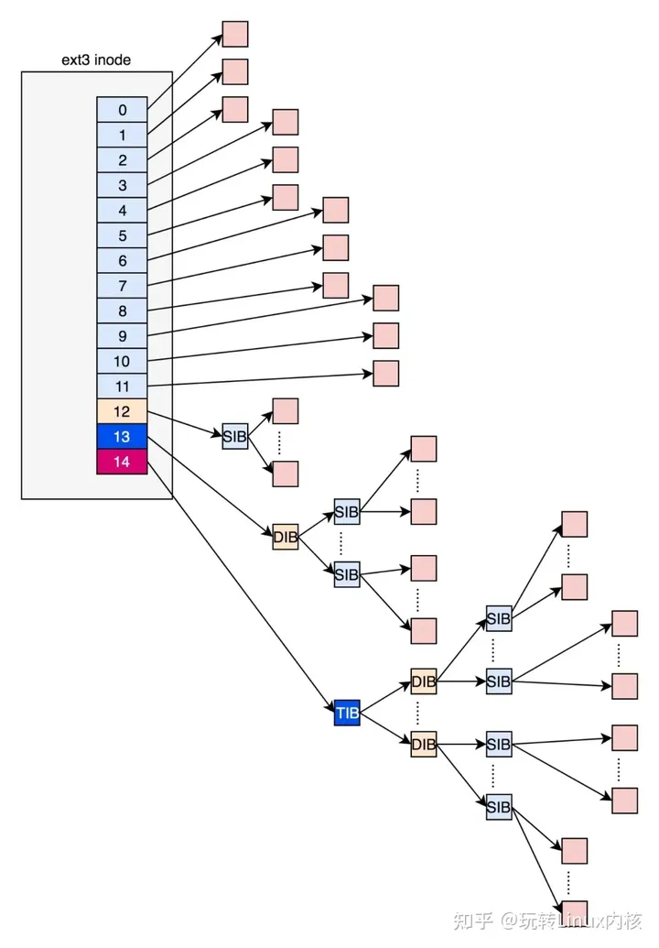
Combined Scheme: UNIX (4K bytes per block)

Slide 82
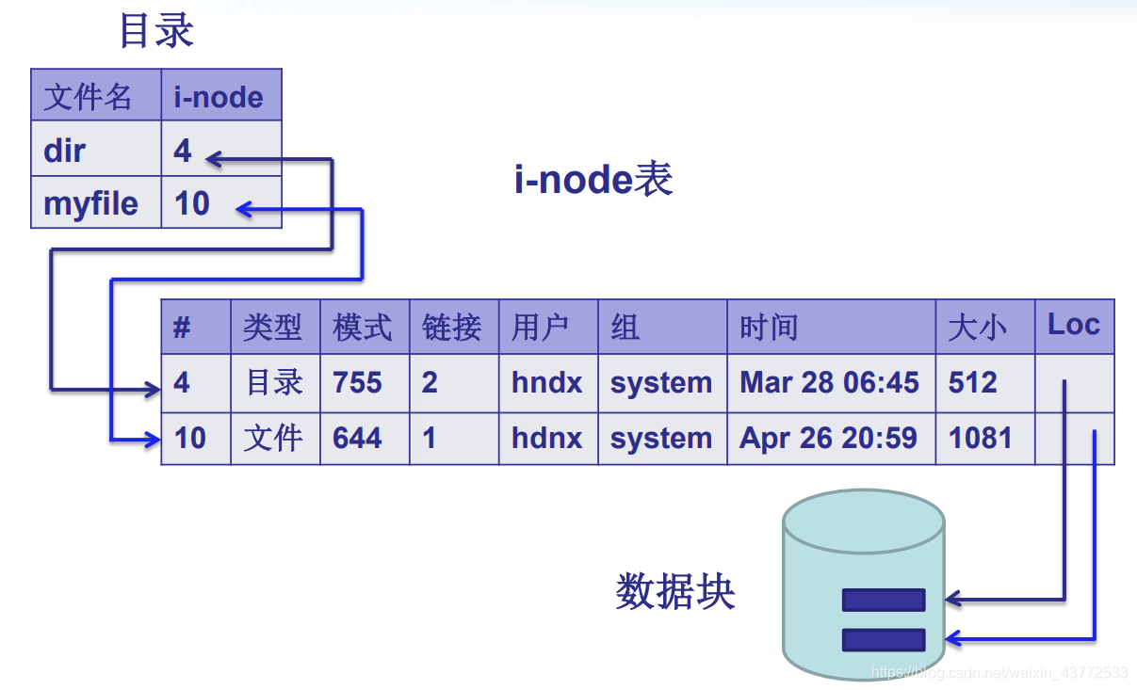
回顾：UNIX文件目录表与索引结点
思考：这里的loc指向文件的数据块。
如何指向？

Slide 83
回顾：基于文件名+inode号目录项查找文件过程
打开一个文件时，文件系统必须要根据文件名定位它所在的磁盘块
例如在UNIX中，要查找/usr/ast/mbox
分析路径名，需要从根(/)开始查找，因此，首先定位根目录表。根目录的索引结点号是固定的，或者说根目录表存放在磁盘上固定的位置（假设存放在1号磁盘块中）
在根目录表中，依据路径的第一个分量usr，获取/usr目录的索引节点号；根据索引节点号查找索引节点表，找到/usr的索引结点结构，从中获取存放/usr目录表的数据块。
依次类推，找到文件mbox的索引节点，从中获取文件mbox对应的文件信息。
查找/usr/ast/mbox的过程

Slide 84
回顾：Combined Scheme
采用混合形式存储一般文件、目录文件等文件的数据块
索引结点表
root /
文件名/目录名 | Inode号
a.txt | 1
D1 | 2
D2 | 3
结点号 | 索引结点结构
0 | Inode结构体
1 | Inode结构体
2 | Inode结构体
3 | Inode结构体
4 | Inode结构体
5 | Inode结构体
6 | Inode结构体
7 | Inode结构体
8 | Inode结构体
9 | Inode结构体
10 | Inode结构体
root数据块
a.txt数据块
D1数据块
D2数据块
目录 D1
目录 D2
b.c数据块
文件名/目录名 | Inode号
b.c | 4
DD1 | 5
文件名/目录名 | Inode号
DD1数据块

Slide 85
回顾：Combined Scheme
root /
索引结点表
文件名/目录名 | Inode号
a.txt | 1
D1 | 2
D2 | 3
在目录D2中创建文件c.txt，与目录DD2
结点号 | 索引结点结构
0 | Inode结构体
1 | Inode结构体
2 | Inode结构体
3 | Inode结构体
4 | Inode结构体
5 | Inode结构体
6 | Inode结构体
7 | Inode结构体
8 | Inode结构体
root数据块
a.txt数据块
D1数据块
D2数据块
目录 D1
目录 D2
b.c数据块
文件名/目录名 | Inode号
b.c | 4
DD1 | 5
文件名/目录名 | Inode号
c.txt | 6
DD2 | 7
DD1数据块
c.txt数据块
DD2数据块

Slide 86
回顾： Combined Scheme
root /
索引结点表
文件名/目录名 | Inode号
a.txt | 1
D1 | 2
D2 | 3
在目录D1中创建文件c.txt对应的硬连接c.txt
结点号 | 索引结点结构
0 | Inode结构体
1 | Inode结构体
2 | Inode结构体
3 | Inode结构体
4 | Inode结构体
5 | Inode结构体
6 | Inode结构体
7 | Inode结构体
8 | Inode结构体
9 | Inode结构体
10 | Inode结构体
root数据块
a.txt数据块
D1数据块
D2数据块
目录 D1
目录 D2
b.c数据块
DD1数据块
文件名/目录名 | Inode号
b.c | 4
DD1 | 5
c.txt | 6
文件名/目录名 | Inode号
c.txt | 6
DD2 | 7
c.txt数据块
DD2数据块

Slide 87
回顾： Combined Scheme
root /
索引结点表
文件名/目录名 | Inode号
a.txt | 1
D1 | 2
D2 | 3
在目录D2中创建文件b.c对应的软连接f.c
结点号 | 索引结点结构
0 | Inode结构体
1 | Inode结构体
2 | Inode结构体
3 | Inode结构体
4 | Inode结构体
5 | Inode结构体
6 | Inode结构体
7 | Inode结构体
8 | Inode结构体
9 | Inode结构体
10 | Inode结构体
root数据块
a.txt数据块
D1数据块
目录 D1
目录 D2
D2数据块
文件名/目录名 | Inode号
b.c | 4
DD1 | 5
c.txt | 6
b.c数据块
文件名/目录名 | Inode号
c.txt | 6
DD2 | 7
f.c | 8
DD1数据块
c.txt数据块
DD2数据块
f.c的数据块
软连接类似于Windows中的快捷方式，在软连接文件中存有目标文件的访问路径

Slide 88
回顾： Combined Scheme
root /
索引结点表
文件名/目录名 | Inode号
a.txt | 1
D1 | 2
D2 | 3
移动D1/b.c到D2/b.c
结点号 | 索引结点结构
0 | Inode结构体
1 | Inode结构体
2 | Inode结构体
3 | Inode结构体
4 | Inode结构体
5 | Inode结构体
6 | Inode结构体
7 | Inode结构体
8 | Inode结构体
9 | Inode结构体
10 | Inode结构体
root数据块
a.txt数据块
D1数据块
目录 D1
目录 D2
D2数据块
文件名/目录名 | Inode号
DD1 | 5
c.txt | 6
b.c数据块
文件名/目录名 | Inode号
c.txt | 6
DD2 | 7
f.c | 8
b.c | 4
DD1数据块
c.txt数据块
DD2数据块
f.c的数据块
注：移动没有建立新文件，文件可以使用原索引结点号

Slide 89
回顾： Combined Scheme
root /
索引结点表
文件名/目录名 | Inode号
a.txt | 1
D1 | 2
D2 | 3
复制D2/c.txt到D1/h.txt
结点号 | 索引结点结构
0 | Inode结构体
1 | Inode结构体
2 | Inode结构体
3 | Inode结构体
4 | Inode结构体
5 | Inode结构体
6 | Inode结构体
7 | Inode结构体
8 | Inode结构体
9 | Inode结构体
10 | Inode结构体
root数据块
a.txt数据块
D1数据块
目录 D1
目录 D2
D2数据块
文件名/目录名 | Inode号
h.txt | 9
DD1 | 5
c.txt | 6
b.c数据块
文件名/目录名 | Inode号
c.txt | 6
DD2 | 7
f.c | 8
b.c | 4
DD1数据块
c.txt数据块
DD2数据块
f.c的数据块
h.Txt的数据块
注：建立新文件需要新的索引结点

Slide 90
回顾： Combined Scheme
root /
索引结点表
文件名/目录名 | Inode号
a.txt | 1
D1 | 2
D2 | 3
删除一个文件或目录，释放对应的目录表项，以及索引结点项
结点号 | 索引结点结构
0 | Inode结构体
1 | Inode结构体
2 | Inode结构体
3 | Inode结构体
4 | Inode结构体
5 | Inode结构体
6 | Inode结构体
7 | Inode结构体
8 | Inode结构体
9 | Inode结构体
10 | Inode结构体
root数据块
a.txt数据块
D1数据块
目录 D1
目录 D2
D2数据块
文件名/目录名 | Inode号
h.txt | 9
DD1 | 5
c.txt | 6
b.c数据块
文件名/目录名 | Inode号
c.txt | 6
DD2 | 7
f.c | 8
b.c | 4
DD1数据块
c.txt数据块
DD2数据块
f.c的数据块
h.Txt的数据块

Slide 91
单选题
答案解析
1分
答案解析
为支持CD-ROM中视频文件的快速随机播放，播放性能最好的文件数据块组织方式是（）。
A
A
连续结构
B
链式结构
C
直接索引结构
D
多级索引结构
提交
可为此题添加文本、图片、公式等解析，且需将内容全部放在本区域内。正常使用需3.0以上版本

Slide 92
单选题
答案解析
1分
答案解析
下列文件结构中，适合随机访问且易于文件扩展的是（）。
此题未设置答案，请点击右侧设置按钮
B
A
连续结构
B
索引结构
C
链式结构且磁盘块定长
D
链式结构且磁盘块变长
提交
可为此题添加文本、图片、公式等解析，且需将内容全部放在本区域内。正常使用需3.0以上版本

Slide 93
单选题
答案解析
1分
答案解析
此题未设置答案，请点击右侧设置按钮
设文件索引节点中有7个地址项，其中4个地址项为直接地址索引，2个地址项是一级间接地址索引，1个地址项是二级间接地址索引，每个地址项大小为4字节，若磁盘索引块和磁盘数据块大小均为256字节，则可表示的单个文件的最大长度是（） KB。
C
最大文件的块数：
4+(256/4)*2+(256/4)*(256/4)=4228 块
最大文件的字节数：
4228块*256B=1082368 B
1082368B/1024B=
1057KB
A
33
B
519
C
1057
D
16513
提交
可为此题添加文本、图片、公式等解析，且需将内容全部放在本区域内。正常使用需3.0以上版本

Slide 94
单选题
答案解析
1分
答案解析
某文件系统的索引节点(inode)中有直接地址项和间接地址项，则下列选项中，与单个文件长度无关的因素是（）。
此题未设置答案，请点击右侧设置按钮
A
A
索引节点的总数
B
间接地址索引的级数
C
地址项的个数
D
文件块大小
提交
可为此题添加文本、图片、公式等解析，且需将内容全部放在本区域内。正常使用需3.0以上版本

Slide 95
单选题
答案解析
1分
答案解析
此题未设置答案，请点击右侧设置按钮
在文件的索引节点中存放直接索引指针10个，一级和二级索引指针各一个。磁盘块大小1KB，每个索引指针占4字节。若某文件的索引节点已在内存中，则把该文件偏移量（按字节编址）为1234和307400处所在的磁盘块读入内存，需访问的磁盘块个数分别是（）。
文件偏移量1234在文件的第1号数据块中，从索引节点的直接块直接访问，故1次。
文件偏移量307400在第文件的第300号块中，1直接块有10个，一级索引块有254块（1KB/4=256），因此访问该偏移量处的文件内容需要通过二级索引块访问，故3次。
故B。
文件偏移量0~1024*10-1，即0~10239所对应的磁盘块号放在10个直接索引指针中；
每个索引占用4字节，一个磁盘块中可保存1024/4=256个索引指针，则文件偏移量为10240~10240+256*1024-1，即10240~272383所对应的磁盘块号对应一级索引大于等于10240+256*1024（272384）的磁盘块号对应二级索引。
故（1,3），选B
A
1,2
B
1,3
C
2,3
D
2,4
提交
可为此题添加文本、图片、公式等解析，且需将内容全部放在本区域内。正常使用需3.0以上版本

Slide 96
主观题
10分
某文件系统空间的最大容量为4TB（1TB=2⁴⁰B），以磁盘块为基本分配单位，磁盘块大小为1KB。FCB包含一个512B的索引表区。请回答：
（1）假设索引表区仅采用直接索引结构，索引区存放文件占用的磁盘块号。索引表项中块号最少占用多少字节？可支持的单个文件最大长度是多少字节？
（2）假设索引表区采用如下结构：第0~7字节采用<起始块号，块数>格式表示文件创建时预分配的连续存储空间，其中起始块号占6B，块数占2B；剩余504字节采用直接索引结构，一个索引项占6B，则可支持的单个文件最大长度是多少字节？
为了使单个文件的长度达到最大，请指出起始块号和块数分别所占字节数的合理值，并说明理由。
正常使用主观题需2.0以上版本雨课堂
作答

Slide 97
续上页
（1）该文件系统空间总的盘块数为4TB/1KB=4G=2³²个，则索引表项中块号最少需要32位/8位=4字节，每个文件的FCB中索引表区空间为512B，最多可有的表项数为512B/4B=128个。因此每个文件最多可分配128个磁盘块，可支持的单个文件最大长度为128*1KB=128KB。
（2）在<起始块号，块数>格式中，块数占2B，为文件预分配的磁盘数最多为2¹⁶块，因此预分配的连续空间最大为1KB*2¹⁶=64MB。直接索引结构部分空间为504B，每个索引项占6B，则直接索引结构最多可表示的磁盘块数为504B/6B=84块，可支持的文件最大长度为1KB*84=84KB。综上所述，该地址结构可支持的单个文件的最大长度为64MB+84KB=65620KB。
该文件系统空间总的盘块数为4TB/1KB=4G=2³²个，盘块数与盘块号均可采用4个字节表示，因此为了使单个文件的长度达到最大，起始块号和块数所占字节数均为4，即采用<4,4>格式，则预分配的连续空间最大为2³²*1KB= 2⁴²B= 4TB，加上直接索引结构支持的文件最大长度84KB，单个文件的最大长度为4TB +84KB。

Slide 98
主观题
10分
某文件系统为一级根目录结构，文件的数据一次性写入磁盘，已写入的文件不可修改，但可多次创建新文件。请回答如下问题：
（1）在连续、链式、索引三种文件的数据块组织方式中，哪种更合适？说明理由。
为定位文件数据块，需要在FCB中设置哪些相关描述字段？
（2）为快速找到文件，对于FCB，是集中存储好，还是与对应的文件数据块连续存储好？说明理由。
正常使用主观题需2.0以上版本雨课堂
作答

Slide 99
续上页
（1）连续数据块组织方式更合适
文件的数据一次性写入磁盘，已写入的文件不可修改，因此不存在文件的插入、扩展等问题；
使用连续方式不仅可以省去链式、索引中的额外磁盘块的开销，而且支持随机访问，查找速度及访问速度更快，实现简单。
在连续方式中，为定位文件数据块，需要在FCB中设置文件在外存中的首个磁盘块号，以及文件所占的磁盘块数。
（2）FCB集中存储较好
FCB存储了文件的详细信息，查找文件需要访问FCB。
由于是采用连续文件分配方式，集中存储可减少检索文件时访问磁盘的次数，提高检索和访问速度。

Slide 100
习题 P448
11.6 Consider a file system on a disk that has both logical and physical block sizes of 512 bytes.
Assume that the information about each file is already in memory.
For each of the three allocation strategies (contiguous, linked, and indexed), answer these questions:
a. How is the logical-to-physical address mapping accomplished in this system? (For the indexed allocation, assume that a file is always less than 512 blocks long.)
b. If we are currently at logical block 10 (the last block accessed was block 10) and want to access logical block 4, how many physical blocks must be read from the disk?

Slide 101
习题 P448参考答案
Answer: Let S be the starting file address (block number).
a. Contiguous. Divide the logical address by 512 with Q and R the resulting quotient and remainder respectively.
1. Add Q to S to obtain the physical block number. R is the displacement into that block.
2. 1
b. Linked. Divide the logical physical address by 511 with Q and R the resulting quotient and remainder respectively.
1. Chase down the linked list (getting Q + 1 blocks). R is the displacement into the last physical block.
2. 4? (5?) (0→4th block)
c. Indexed. Divide the logical address by 512 with Q and R the resulting quotient and remainder respectively.
1. Get the index block into memory. Physical block address is contained in the index block at location Q. R is the displacement into the desired physical block.
2. 2 （one for the index block, another for the data block ）

Slide 102
11.5 Free-Space Management
Bit vector (Bit Map)
Linked list (free list)
Grouping
Counting
每种方法的评价指标：
是否需要额外的磁盘空间？需要多少？
是否容易找到连续块？
效率：空间分配与回收的效率
不管采用哪种文件分配方式，操作系统总是尽量为文件分配连续的磁盘块；

Slide 103
11.5.1 Bit vector (Bit Map)
Bit vector (n blocks)
Each block is represented by 1 bit
0
1
2
n-1
…
0 ⇒ block[i] occupied (allocated)
1 ⇒block[i] free
bit[i] =

Block number calculation：
(number of bits per word) *
(number of 0-value words) +
offset of first 1 bit

Slide 104
Free-Space Management (Cont.)
Bit map requires extra space
Example:
block size = 2¹² bytes
disk size = 2³⁰ bytes (1 gigabyte)
n = 2³⁰/2¹² = 2¹⁸ bits = 2¹⁸/2³ bytes=2¹⁵bytes(or 32K bytes)
Relative simplicity
Easy to get contiguous files
Bit vectors are inefficient unless the entire vector is kept in main memory (and is written to disk occasionally for recovery needs).
Keeping it in main memory is possible for smaller disks but not necessarily for larger ones.
实现：位示图存储在磁盘上，检索时装入主存；
位示图在磁盘上的位置放在超级块中；

Slide 105
例题
某磁盘文件区16GB ,每个磁盘块大小为1KB，回答下列问题：（列出解题步骤）
如果空闲存储空间采用位示图（位向量）管理方法，那么位示图需要占用多少个盘块？

Slide 106
例题—参考答案
磁盘总盘字节数 (16GB) ：16* 2³⁰ =2³⁴字节
磁盘总块数： 2³⁴ 字节/2¹⁰ (字节/块)= 2²⁴ 块
存储位示图需要的位数： 2²⁴ 位 (每块对应1位)
存储位示图需要的字节数：2²⁴位 /8(位/字节)=2²¹字节
位示图所占盘块数： 2²¹字节/2¹⁰ (字节/块)=2¹¹块 (2k块)

Slide 107
单选题
答案解析
1分
答案解析
文件系统用位示图表示磁盘空间的分配情况，位示图存于磁盘的32~127号块中，每个盘块占用1024个字节，盘块和块内字节均从0开始编号。假设要释放的盘块号为409612，则位示图中要修改的位所在的盘块号和块内字节序号分别是（）。（2015）
此题未设置答案，请点击右侧设置按钮
每块大小为1024字节=1024*8=8096位;
409612/8096=50…12，位示图的盘块号从0开始编号，则盘块409612在位示图的第50号块的第12位，即第50号块的第1号字节中（第12位处于第2个字节，因字节序号从0开始编址，故为1号字节）；
位示图的起始块号为32，则为32+50=82号块物理块的第1号字节中。
故 选择C
A
81,1
B
81,2
C
82,1
D
82,2
提交
可为此题添加文本、图片、公式等解析，且需将内容全部放在本区域内。正常使用需3.0以上版本

Slide 108
11.5.2 Linked list
Linked list (free list)
将所有空闲磁盘块用链表链接起来；
并将指向第一个空闲块的头指针保存在磁盘的特殊位置（如Super block），同时也缓存在内存中；
(类似于页式管理中的空闲帧列表)
实现简单
空闲块的回收与分配也较为方便
No waste of space（不占用额外的磁盘空间）
Cannot get contiguous space easily
实现：链表的头部放在超级块中；

Slide 109
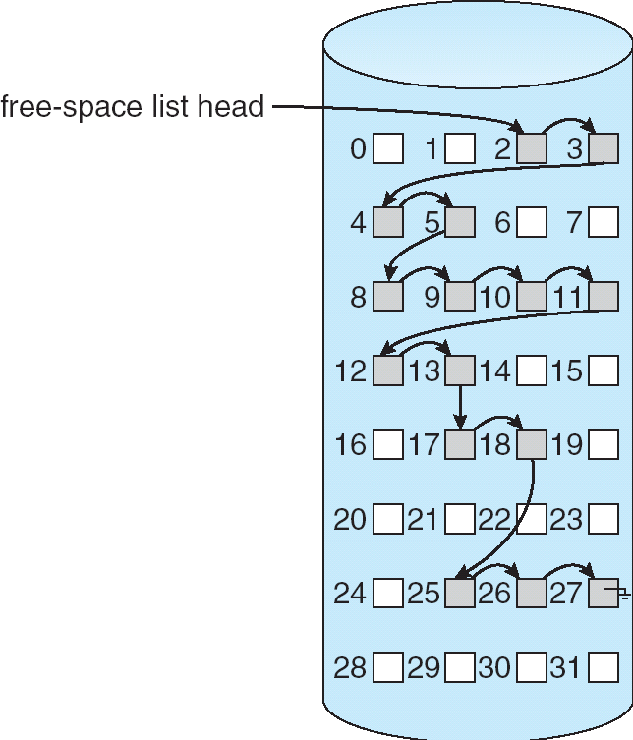
Linked Free Space List on Disk

Slide 110
11.5.3 Grouping
对于链接分配的一种改进
专门设置一些磁盘块临时存储多个空闲磁盘块的块号；
磁盘块号保存在同一个磁盘块中的那些空闲磁盘块，构成一组。
是为成组链接法；
Grouping （UNIX使用的 “成组链接法”）
将n个空闲块分成一组，每组中的第一块或最后一块保存下一组的空闲块地址，依次类推；
第一组的块地址保存在一个特殊空闲块中；
No waste of space（不占用额外的磁盘空间）
当前可分配的物理块号存放在空闲盘块栈，因此绝大部分的分配和回收工作是在主存中进行，可以节省时间，与bit vector相比，占用内存较少；
Cannot get contiguous space easily
与链接法不同，该方法容易找到大量的空闲块；

Slide 111
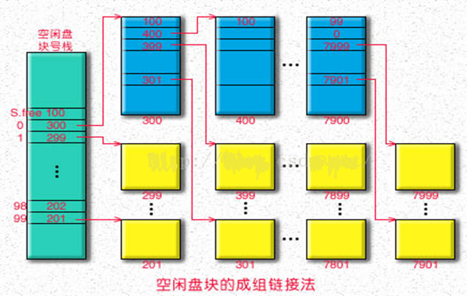
Grouping (Cont.)
第一组 第二组 第三组 ……
成组链接法空闲盘块的组织

Slide 112
Grouping (Cont.)
第一组 第二组 第三组 ……
成组链接法空闲盘块的组织

Slide 113
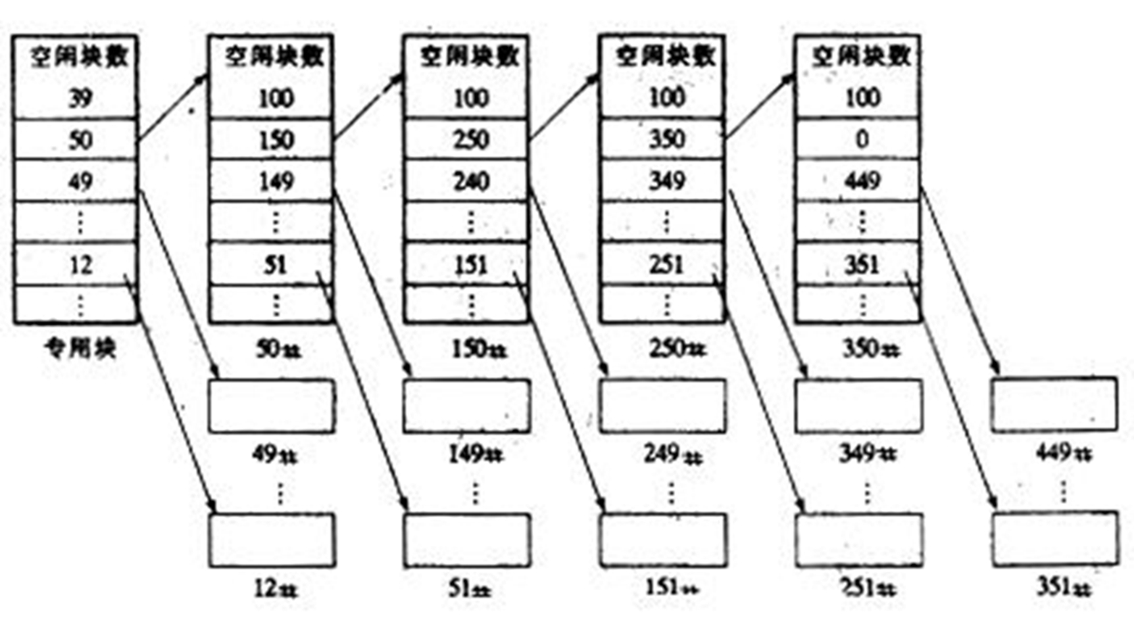
Grouping (Cont.)
第一组 第二组 第三组 ……

Slide 114
Grouping (Cont.)

Slide 115
Grouping
空闲磁盘块的回收 （最左边一组：从上往下，从右向左）
空闲盘块号栈在超级块中
假定空闲盘块号栈是向下生长的
当最左边的组空闲块数未达到规定数，如100，则新回收的空闲块的块号入栈（放到空闲盘块号栈的栈顶）（从上往下）
当最左边的组空闲磁盘块数达到规定次数后，如100,；再回收一块空闲块后，先将空闲盘块号栈的空闲块号信息复制到该块中，同时将空闲盘块号栈清空；然后该块作为新的一组空闲块的第一块，并将该块号入栈
以此类推
空闲磁盘块的分配（最左边一组：从下往上，从左向右）
依次分配空闲盘块号栈栈顶的空闲块
当要分配空闲盘块号栈栈底所示的块号时，先把该块所保存的其下一组的空闲磁盘块号信息写入空闲盘块号栈中，然后再将该空闲块分配出去
注：分配与回收过程所涉及的块信息操作均在空闲盘块号栈中进行

Slide 116
11.5.4 Counting
Counting
建立一个类似于分区内存管理中的分区表；
每个表项记录第一块的块号和与第一块连续的空闲块的数量；
容易找到连续的空间
分配与回收也比较方便
需要额外的空间

Slide 117
Counting
Requires extra space（磁盘上有一个“空闲盘块表”）；
为磁盘上的每个空闲连续存储空间中的磁盘块建立一个表项 ；
适合连续文件空间的连续分配；
需要额外的空间
序号 | 第一空闲盘块表 | 空闲盘块数
1 | 1 | 4
2 | 9 | 3
3 | …… | ……

Slide 118
回顾
为对文件进行管理，操作系统设置了哪些数据结构？
在磁盘上设置了哪些数据结构？
在内存中设置了哪些数据结构？
结合open、read、write等系统调用，说明这些数据结构的功能与作用。

Slide 119
11.6 Efficiency and Performance
Efficiency dependent on:
disk allocation and directory algorithms
types of data kept in file’s directory entry
Performance
disk cache – separate section of main memory for frequently used blocks
free-behind and read-ahead – techniques to optimize sequential access
improve PC performance by dedicating section of memory as virtual disk, or RAM disk

Slide 120
11.6.1 Efficiency
Efficiency dependent on:
Disk allocation algorithms and directory algorithms
Types of data kept in file’s directory entry（如FCB中项越多，存储与访问效率越低，但方便）
Ext文件系统，索引节点（FCB）预先创建
即使空闲也占用一定的空间，但分配效率高；
如果集中分配在磁盘起始位置，可能与文件数据块距离比较远，增大磁头的寻道时间；
如果预先散列分配在整个磁盘空间中，可以使文件数据与其对应的索引节点存放在一起，降低寻道时间；
该方案不适应于磁盘块不连续的文件
应尽量将文件内容存放到连续的磁盘块中，如NTFS
为了备份的需要（增量备份） ，需要保存文件的“最近访问时间” ，增加了文件目录与FCB的读写频率；

Slide 121
11.6.2 Performance
Performance
原则：访问文件时，尽量减少磁盘的访问频率
Disk cache – separate section of main memory for frequently used blocks
Free-behind and read-ahead – techniques to optimize sequential access
考虑到文件大部分都是顺序访问，因此已经读入的磁盘块可能还要访问，并且可能要继续访问其后的几个磁盘块，因此采用延迟释放与提前预读技术；（提前预读采用异步读）
Free-behind ：要让磁盘块在内存中驻留尽量长的时间；
Improve PC performance by dedicating section of memory as virtual disk, or RAM disk.

Slide 122
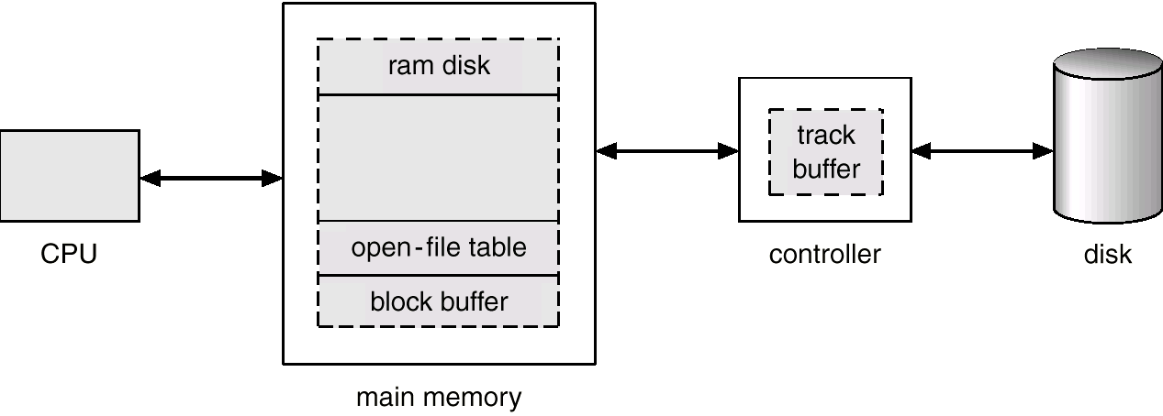
Various Disk-Caching Locations

Slide 123
Page Cache
A page cache caches pages rather than disk blocks using virtual memory techniques
Memory-mapped I/O uses a page cache
Routine I/O through the file system uses the buffer (disk) cache
This leads to the following figure

Slide 124
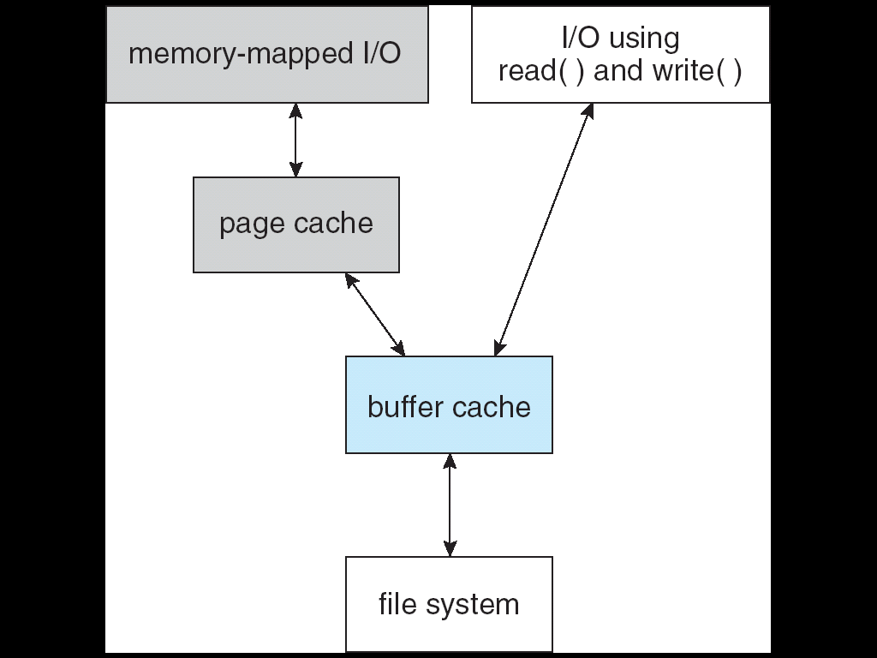
I/O Without a Unified Buffer Cache

Slide 125
Unified Buffer Cache
A unified buffer cache uses the same page cache to cache both memory-mapped pages and ordinary file system I/O;

Slide 126
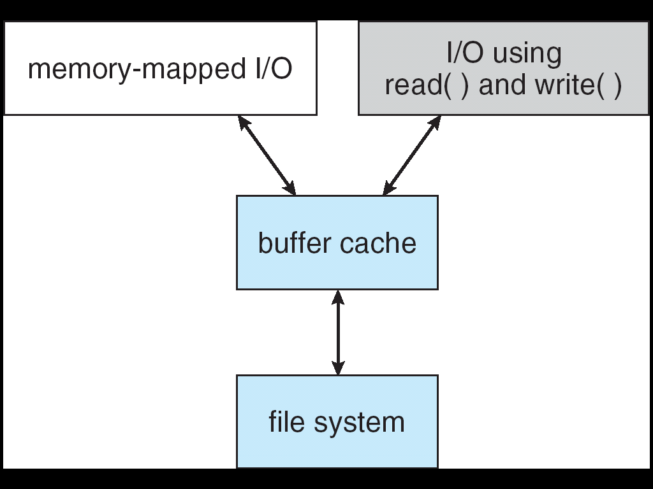
I/O Using a Unified Buffer Cache

Slide 127
11.7 Recovery
Consistency checking – compares data in directory structure with data blocks on disk, and tries to fix inconsistencies
Use system programs to back up data from disk to another storage device (floppy disk, magnetic tape, other magnetic disk, optical)
Recover lost file or disk by restoring data from backup

Slide 128
11.8 Log Structured File Systems
Log structured (or journaling) file systems record each update to the file system as a transaction
All transactions are written to a log
A transaction is considered committed once it is written to the log
However, the file system may not yet be updated
The transactions in the log are asynchronously written to the file system
When the file system is modified, the transaction is removed from the log
If the file system crashes, all remaining transactions in the log must still be performed

Slide 129
11.9 The Sun Network File System (NFS)
An implementation and a specification of a software system for accessing remote files across LANs (or WANs)
The implementation is part of the Solaris and SunOS operating systems running on Sun workstations using an unreliable datagram protocol (UDP/IP protocol and Ethernet

Slide 130
NFS (Cont.)
Interconnected workstations viewed as a set of independent machines with independent file systems, which allows sharing among these file systems in a transparent manner
A remote directory is mounted over a local file system directory
The mounted directory looks like an integral subtree of the local file system, replacing the subtree descending from the local directory
Specification of the remote directory for the mount operation is nontransparent; the host name of the remote directory has to be provided
Files in the remote directory can then be accessed in a transparent manner
Subject to access-rights accreditation, potentially any file system (or directory within a file system), can be mounted remotely on top of any local directory

Slide 131
NFS (Cont.)
NFS is designed to operate in a heterogeneous environment of different machines, operating systems, and network architectures; the NFS specifications independent of these media
This independence is achieved through the use of RPC primitives built on top of an External Data Representation (XDR) protocol used between two implementation-independent interfaces
The NFS specification distinguishes between the services provided by a mount mechanism and the actual remote-file-access services

Slide 132
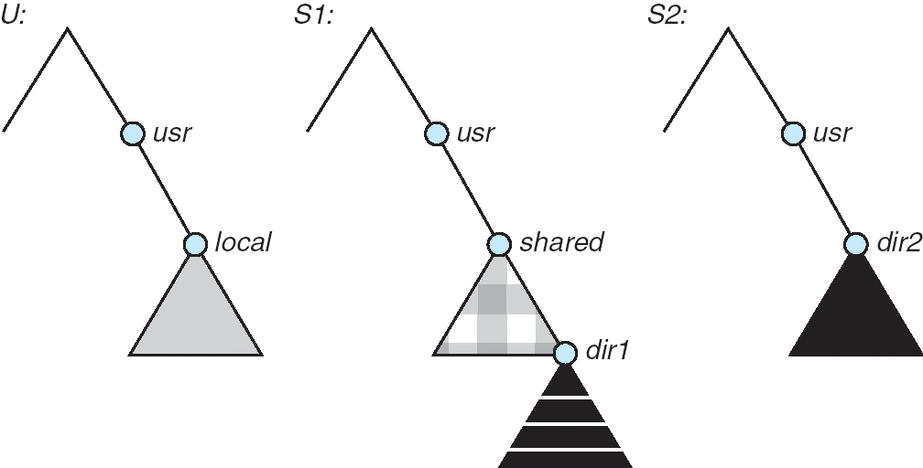
Three Independent File Systems

Slide 133
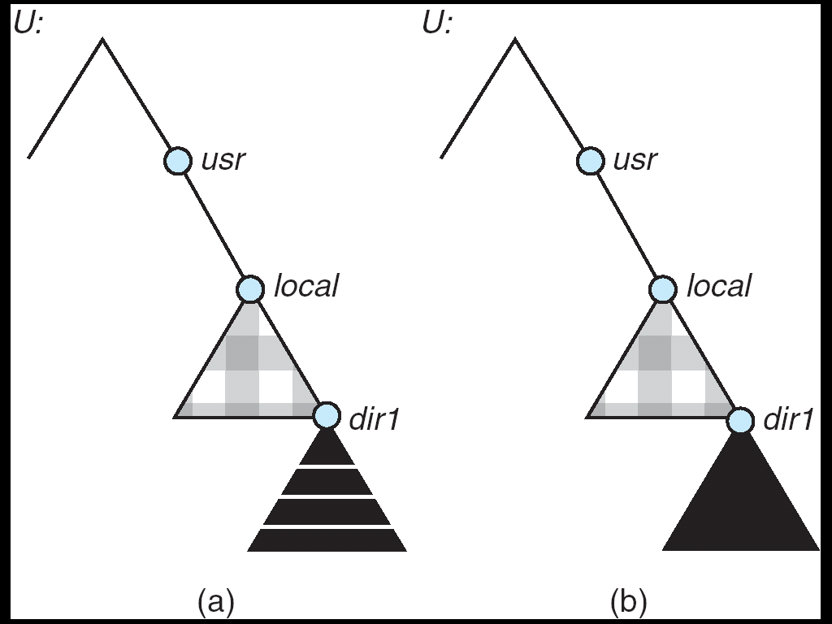
Mounting in NFS
Mounts
Cascading mounts

Slide 134
11.9.2 NFS Mount Protocol
Establishes initial logical connection between server and client
Mount operation includes name of remote directory to be mounted and name of server machine storing it
Mount request is mapped to corresponding RPC and forwarded to mount server running on server machine
Export list – specifies local file systems that server exports for mounting, along with names of machines that are permitted to mount them
Following a mount request that conforms to its export list, the server returns a file handle—a key for further accesses
File handle – a file-system identifier, and an inode number to identify the mounted directory within the exported file system
The mount operation changes only the user’s view and does not affect the server side

Slide 135
11.9.3 The NFS Protocol
Provides a set of remote procedure calls for remote file operations. The procedures support the following operations:
searching for a file within a directory
reading a set of directory entries
manipulating links and directories
accessing file attributes
reading and writing files
NFS servers are stateless; each request has to provide a full set of arguments (NFS V4 is just coming available – very different, stateful)
Modified data must be committed to the server’s disk before results are returned to the client (lose advantages of caching)
The NFS protocol does not provide concurrency-control mechanisms

Slide 136
Three Major Layers of NFS Architecture
UNIX file-system interface (based on the open, read, write, and close calls, and file descriptors)
Virtual File System (VFS) layer – distinguishes local files from remote ones, and local files are further distinguished according to their file-system types
The VFS activates file-system-specific operations to handle local requests according to their file-system types
Calls the NFS protocol procedures for remote requests
NFS service layer – bottom layer of the architecture
Implements the NFS protocol

Slide 137
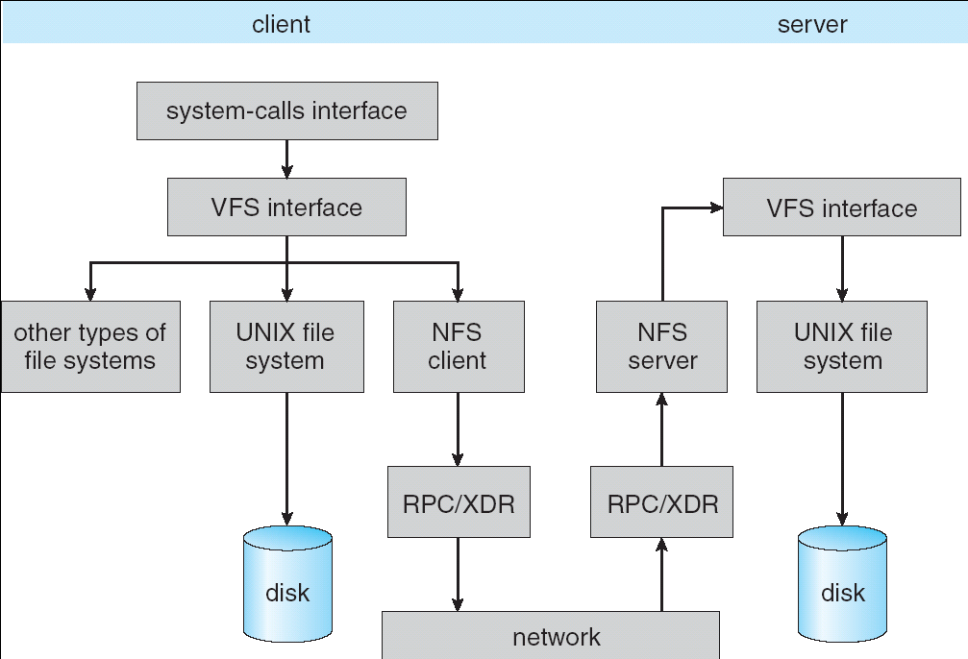
Schematic View of NFS Architecture

Slide 138
11.9.4 NFS Path-Name Translation
Performed by breaking the path into component names and performing a separate NFS lookup call for every pair of component name and directory vnode
To make lookup faster, a directory name lookup cache on the client’s side holds the vnodes for remote directory names

Slide 139
11.9.5 NFS Remote Operations
Nearly one-to-one correspondence between regular UNIX system calls and the NFS protocol RPCs (except opening and closing files)
NFS adheres to the remote-service paradigm, but employs buffering and caching techniques for the sake of performance
File-blocks cache – when a file is opened, the kernel checks with the remote server whether to fetch or revalidate the cached attributes
Cached file blocks are used only if the corresponding cached attributes are up to date
File-attribute cache – the attribute cache is updated whenever new attributes arrive from the server
Clients do not free delayed-write blocks until the server confirms that the data have been written to disk

Slide 140
11.10 Example: WAFL File System
Used on Network Appliance “Filers” – distributed file system appliances
“Write-anywhere file layout”
Serves up NFS, CIFS, http, ftp
Random I/O optimized, write optimized
NVRAM for write caching
Similar to Berkeley Fast File System, with extensive modifications

Slide 141
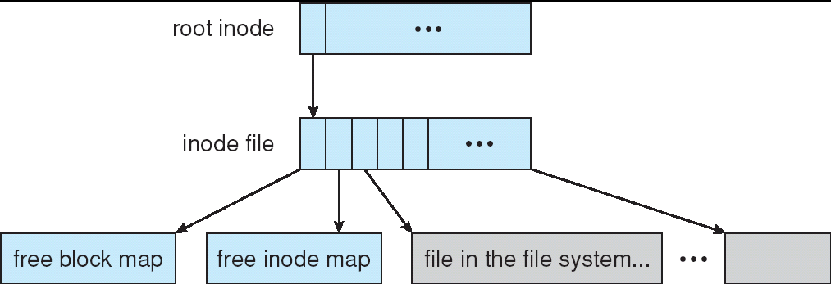
The WAFL File Layout

Slide 142
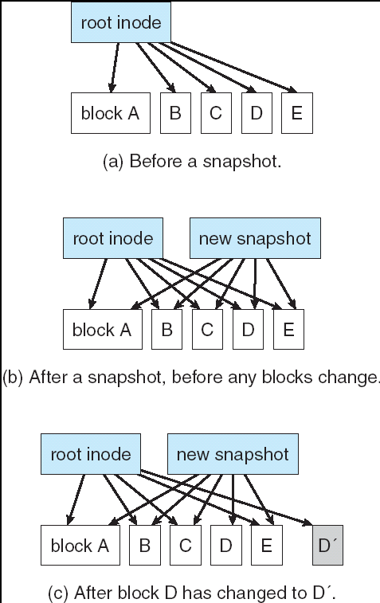
Snapshots in WAFL

Slide 143

11.02

Slide 144
课后复习题
思考
文件目录的作用，实现方法。说明其思想、特点。
内核对open()、write()、read()、close()等系统调用的处理过程；涉及到了哪些数据结构（磁盘以及内存中的数据结构）
VFS的概念、原理及作用；
说明几种文件分配方式的思想、特点，并掌握相关的计算。
如逻辑地址到物理地址的映射；
所需FAT表、索引块等所占磁盘块数的计算等；
UNIX采用混合分配方式，数据块在索引结点中
有关文件操作对目录表、索引结点表的影响
说明几种磁盘空闲空间的管理方法的思想及特点(优点及缺点)，并掌握相关的计算。
如几种文件分配方法所涉及的文件目录表结构、FCB结构等
如位视图所需磁盘块的计算等；P447: 2,6,10
为提高文件系统的性能，可采用哪些措施？

Slide 145
End of Chapter 11

